Slide 1



DARE TO RESEARCH !

Slide 2
What is research ?
Push the boundaries of knowledge
Develop technologies
Understand phenomena
Explain mechanisms
Propose how to use discoveries
Use interdisciplinarity to innovate
Research relies on curiosity, inspiration, and creativity.

Slide 3
Dare to research !
Experiment: use cutting-edge platforms
Discover: an opening to the international stage
Develop your personal & professional network
Build skills: a real asset for your CV!
Take the plunge: fund your studies in the field of research

Slide 4
ORION Clubs
Actively participate in the research activities of PhD students
Benefit from mentoring & develop skills: leadership, project management, scientific skills, written and oral communication, etc.
Club members: motivated students who join and actively take part in research activities.
For whom: from 2nd year undergraduate (Bac+2) to Master’s (Bac+5) and PhD students
Note: compulsory for members of the ORION track
Come and discover & try it out!

Slide 5
"Soft Skills" Workshops
Skills increasingly sought after on the job market: adaptability, critical thinking, autonomy, creativity, problem-solving, etc.
Some schemes provide an actual certification attesting to these skills.
For whom: from Bac+2 to Bac+5 and PhD students (depending on the workshops)
Examples: 48h to bring ideas to life, Materialize your ideas, Business Digitalisation Workshop, 48h to awaken dormant patents, etc.

Slide 6
Personalized Pathway:
The ORION Research Track
Content
Dedicated theoretical courses
Participation in one "Soft Skills" workshop per year (optional)
Participation in free activities within an ORION club
Highlights:
Opportunity to access internship funding through ORION clubs
Opportunity to access international mobility funding through ORION clubs
Awarded a national certificate of excellence in creativity
Develop skills in creativity, collaboration, communication, and critical thinking
Grow your personal and professional network
Possibility of obtaining an ORION excellence scholarship for your Master 2 (7000 euros per year + internship funding)
For whom: 2nd-year undergraduate (L2) and 3rd-year undergraduate (L3)

Slide 7
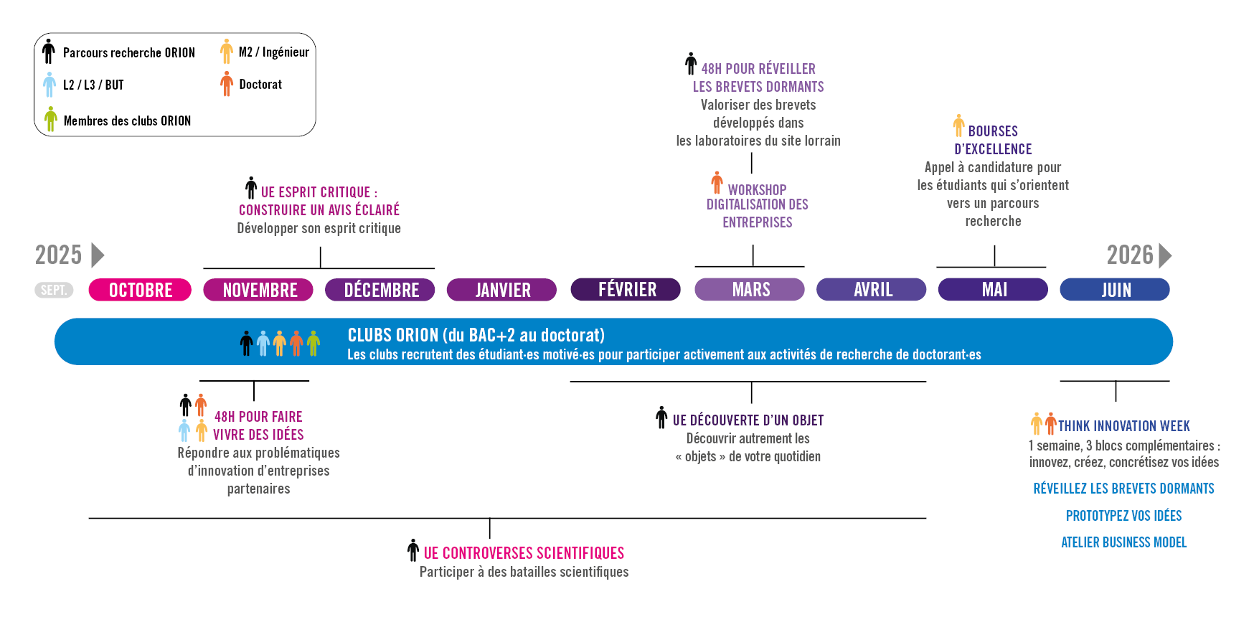
ORION initiatives - timeline

Slide 8
Excellence Scholarships
The excellence scholarships fund one year of Master 2 studies, corresponding to the first semester of coursework followed by the research internship.
The financial aid for the academic year amounts to €7000, plus an internship allowance (5 or 6 months) of €650 per month.

Slide 9
More info:
lue-orion-cellule@univ-lorraine.fr
WWW.UNIV-LORRAINE.FR/OSEZLARECHERCHE/
This work received funding from the French State managed by the National Research Agency under the "Investments for the Future" program, reference ANR-20-SFRI-009.

